Slide 1
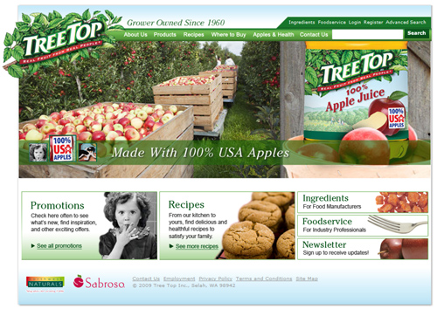
Treetop Custom Website Design
The Challenge
Tree Top wanted a dynamic site that would engage both consumers and food distribution services. The overall goals were to replace the outdated static site, increase site traffic, and inform consumers about food services.
What We Did
Affirma produced wireframes, mood boards, design specs, and conducted a full design review in order to help achieve the look and feel of the company.
We focused on improving not only the design, but also functionality of the site. Affirma allowed Tree Top to access all of their important data from a single source by implementing membership forms, a recipe finder, specialized search, and a custom product lookup piece.
Results
Affirma’s custom website design yielded a dramatic increase in site traffic as well as a more functional and intuitive way to manage content. The Tree Top team was pleased with the enhanced usability of their site, the ease with which design updates could be implemented as needed, and their ability to access product data, recipes, and other key information from a centralized location.

